Slide 1
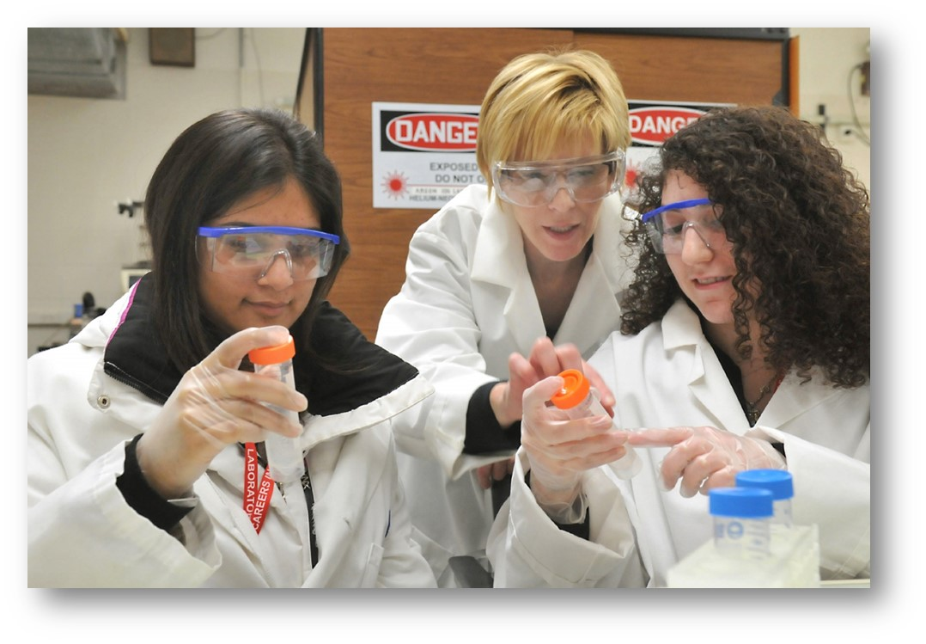
Content-Based Science Instruction for Secondary English Learners
Welcome to TESOL’s

Slide 2
LET’S GET ACQUAINTED…
My name is Emily Miller
I love teaching and learning!
Bachelor of Science in Education; ESL and Bilingual Teaching Licenses;
Master of Science in Curriculum and Instruction; Working on a PHD in Curriculum and Instruction in Science Education
Served as a writer for the Next Generation Science Standards
Teacher for 25 years.

Slide 3
LET’S GET ACQUAINTED…
I have 4 children and 1 husband
I live in Wisconsin, USA
I have 2 guinea pigs and 1 rabbit
I love reading about science
I love reading the current news

Slide 4
LET’S GET ACQUAINTED…
I believe…
knowledge is constructed
learning requires active participation
interaction promotes conceptual understanding
learning is fostered through language development
instruction must be strategically designed, flexible and
dynamic
access to education is a human right

Slide 5
What’s in store for us…
Active learning
Constructive reflection
Lively interaction
Global collaboration
Exploration of multiple perspectives
Introduction to resources and support
Development of practical instructional tools

Slide 6
What’s in each module?
Each module includes:
- Focused objectives
English language development
Best practices for ELA/science
- A variety of activities
Independent learning
Peer- to- peer interaction
Application
-A spectrum of perspectives
Yours + peers = variety!

Slide 7
Course Description
Participants will implement the NGSS in linguistically diverse classrooms. Participants will inform teaching decisions based on knowledge of the stages of English language development and how the stages impact student learning needs. Participants will acquire skills to:
1. Use knowledge of students’ English language skills to inform pedagogical decisions.
2. Differentiate instruction to make science content comprehensible for students with differing language levels.
3. Modify assessments so that they more comprehensively gather evidence of English learner understanding of complex science material.

Slide 8
Module 1:
Review the Education Connections Lesson Plan Template.
Review the science standards you’re currently working with.
Based on the recommendations on writing objectives, develop two language objectives and two content objectives.

Slide 9
Module 2
Discussion and evaluation of strategies for instruction for EL’s.
Reflection on use of strategy.

Slide 10
Module 3:
Synthesis of the three dimensions from the Framework for
K-12 Science Education

Slide 11
Module 4: Introductions
Analysis of assessment for ELs, and suggested modifications.

Slide 12
Module 5
Plan a standards-based science lesson using the Educations Connections Lesson Plan template.
-The lesson should provide differentiated activities to meet the ELs at a minimum of two language levels
-Be sure to state the standards you are teaching and the specific learning target(s) of the lesson.
Teach your lesson and reflect on it based on the rubric provided.

Slide 13
What if I need help?
Contact me with any questions or concerns
Emilycatherine329@gmail.com

Slide 14
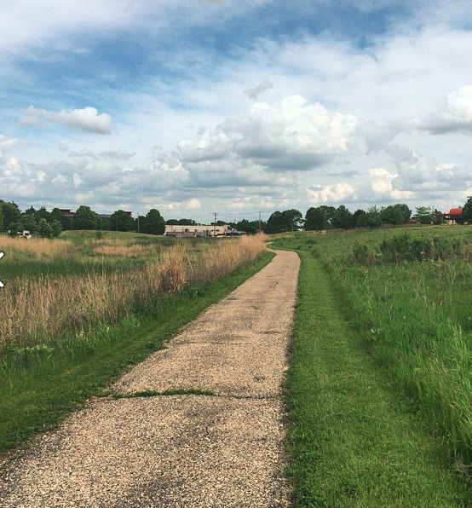
Let’s Go!
Let’s get started!
We will begin with Introduction, and getting the chance
to meet your new community.

